Slide 1



Smart ATS
Names of the Team Members:
1. Mithun Appaji
2. Pavan Kumar BL
3. Yashna H Kanchan
4. Srihari Subramani
5. Ravindra Kumar V
Date: 25/10/2024
Certified AI Engineer race.reva.edu.in

Slide 2
01. Introduction
Background | Current status | Why this Project
07. Software Design
High Level | Low Level Design Diagrams
02. Benchmarks
08. Implementation
Demo | Application
03. Problem Statement
Technical | Functional Problem
09. Testing and Validation
Use Cases | Test Results | Learnings
Agenda
04. Project Objectives
Primary & Secondary Objectives | Expected Outcome
10. Analysis and Results
Key Findings | Insights
05. Cost Evaluation
11. Suggestions and Conclusions
Insights | Next Step | Future Scope
06. Project Methodology
Conceptual Framework | Research Design

Slide 3
Introduction
Background
In today's competitive job market, organizations receive a high volume of resumes for each open position, particularly in specialized fields such as AI and technology. This influx makes it challenging for hiring teams to efficiently identify qualified candidates, leading to potential delays in the hiring process and missed opportunities for top talent.
Current status
The current resume screening process is often manual and time-consuming, resulting in, recruiters spend excessive time sifting through resumes, leading to a backlog and slower hiring times.
Why this topic?
Qualified candidates may be overlooked due to inconsistent screening criteria or the inability to accurately assess their skills and experiences. Inadequate screening processes can result in hires that are not a good fit, contributing to higher turnover rates.
To address these challenges. By leveraging AI and data-driven methodologies, the new resume screening process aims to enhance efficiency, objectivity, and scalability, ultimately leading to better hiring outcomes and a more diverse workforce.

Slide 4






Benchmarks
Time to Hire
Quality of Hire
Candidate Diversity
60 days to week
3 out of 5. to 5 out of 5
20% to 80%
Applicant Satisfaction
Screening Accuracy
Conversion Rates
3 out of 5. to 5 out of 5
30 % to 90%
30 % to 90%
4

Slide 5
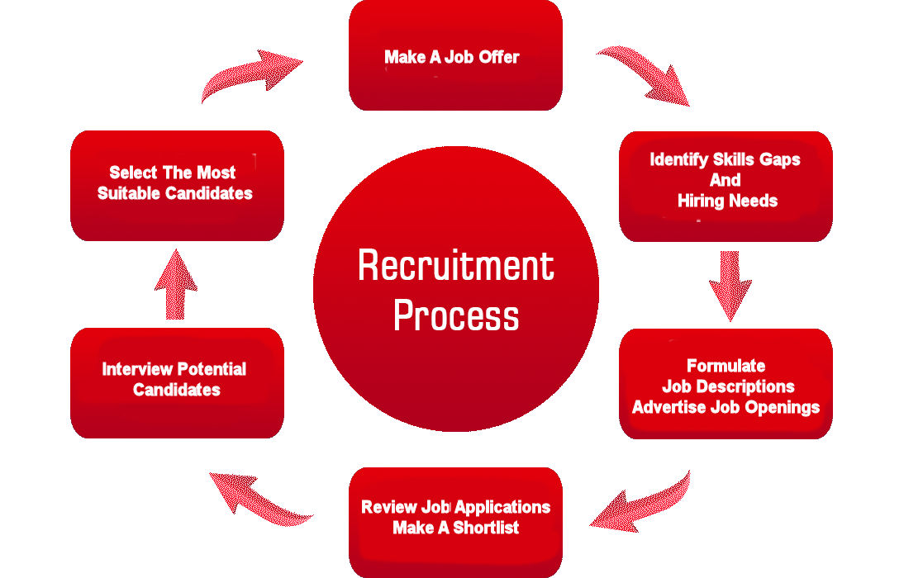
Problem statement
Integration with HR System
Manual Process
Candidates drop out
No Tool to identify skill
Ensuring compliance with data
Manual screening
No automation
Tools and Techniques.
Unconscious bias

Slide 6


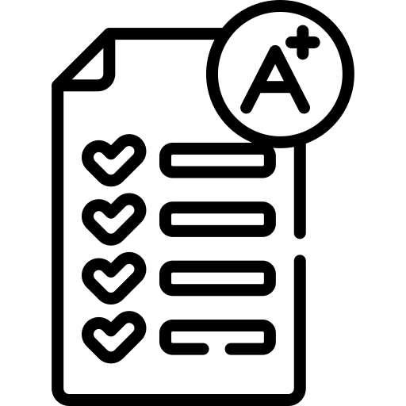

Project Objectives
Automate Resume Screening: Develop a system that automates the initial screening of resumes, reducing the time required for candidate evaluation by at least 50%.
Reduce Bias in Selection: Design the system to minimize bias by focusing on relevant skills and qualifications, with a target of achieving at least a 30% increase in the diversity of candidates selected for interviews.
Scoring: Implement a scoring system based on the similarity between candidate skills and job requirements, providing a
clear metric for ranking candidates. This enables more consistent, quantifiable decision-making.
Provide Predictive Insights: Incorporate predictive analytics that assess candidate fit based on historical data, with the goal of providing actionable insights that improve hiring outcomes by at least 15%.

Slide 7
Cost Evaluation
Current Cost and Time Spent for Screening 100 Resumes for One Job Role
With the Existing Process:
Time Spent:
Each resource works 8 hours/day for 7 days, totalling 56 hours per resource.
With 3 resources, this equals a total of 168 hours.
Cost:
At an hourly rate of $3.75, the total cost for screening 100 resumes is:
168 hours * $3.75 = $630
With a Smart ATS (Applicant Tracking System):
Time Spent:
The Smart ATS reduces the manual screening process to about 5 minutes
Cost:
The cost per resume with the Smart ATS is $0.01
For 100 resumes, the total cost is:
100 resumes = $1
The $1 is scalable up to 10000 resumes

Slide 8
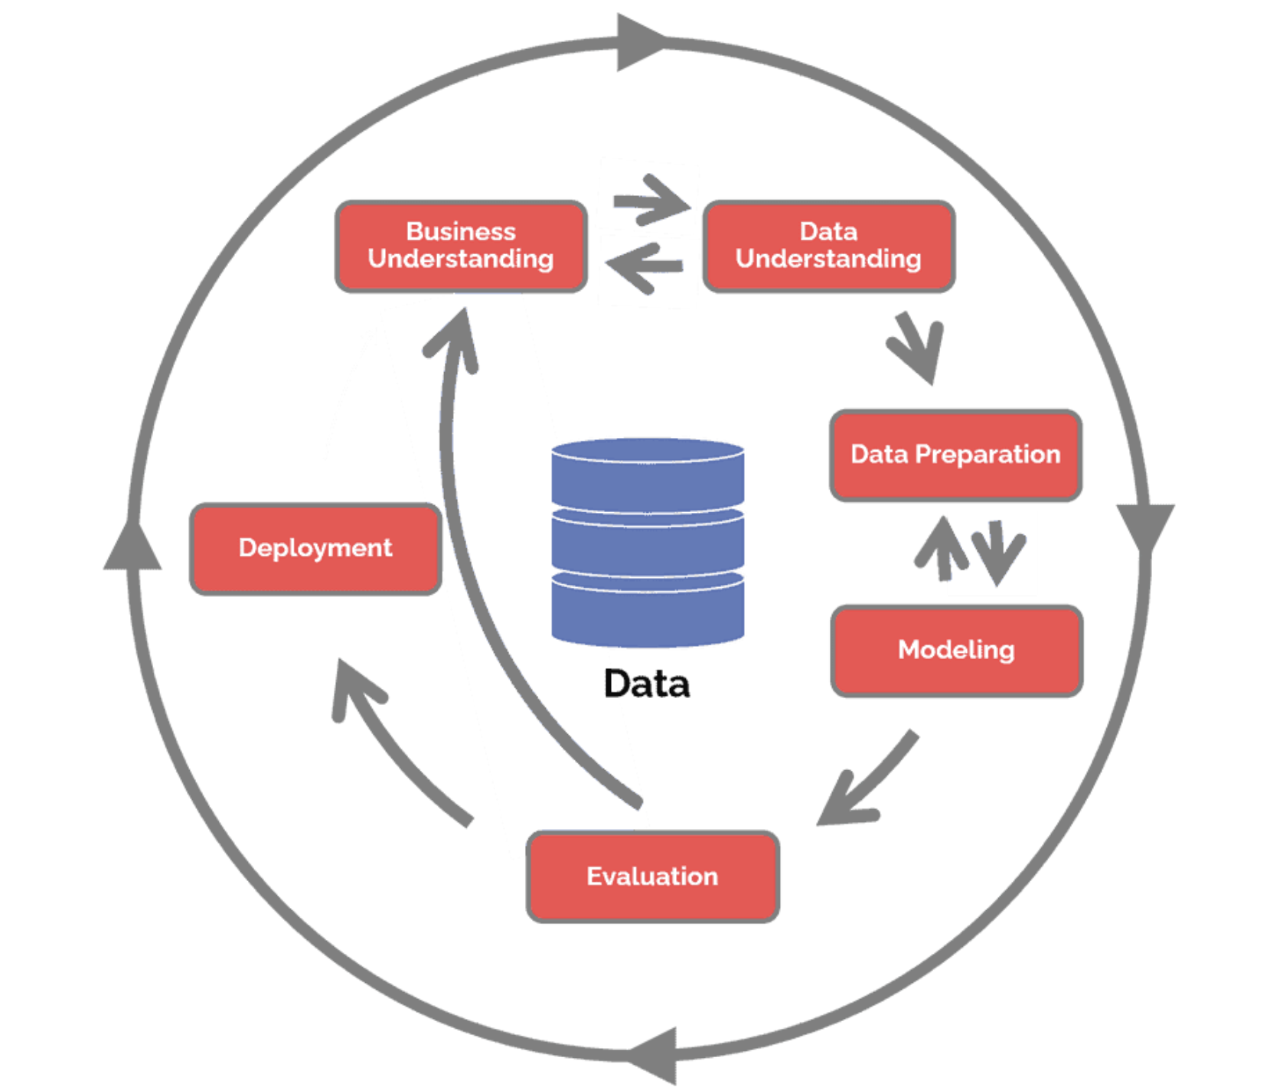
Project Methodology

Slide 9
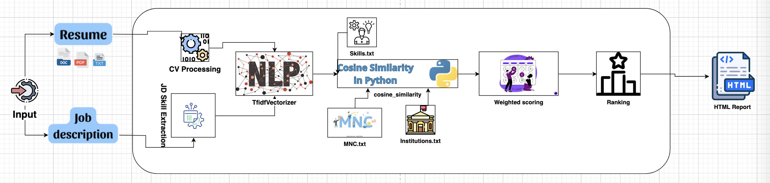
Software Design
High level design

Slide 10


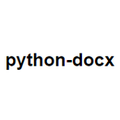





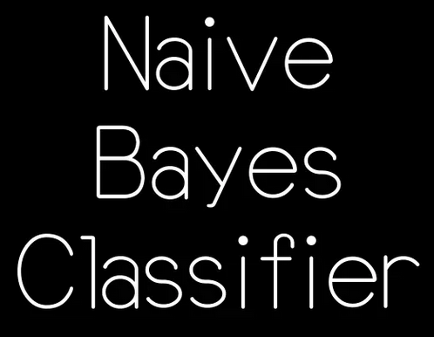
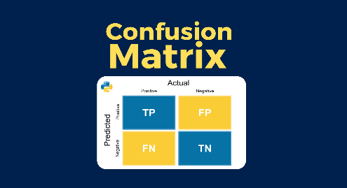
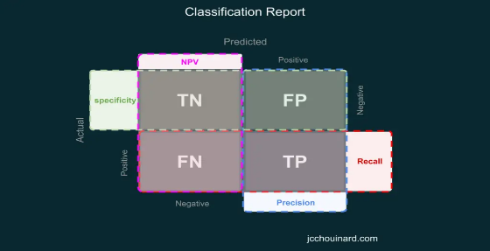

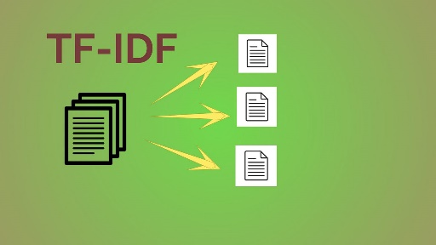
Implementation
Technologies Used
Programming Languages
Frameworks and Libraries

Slide 11
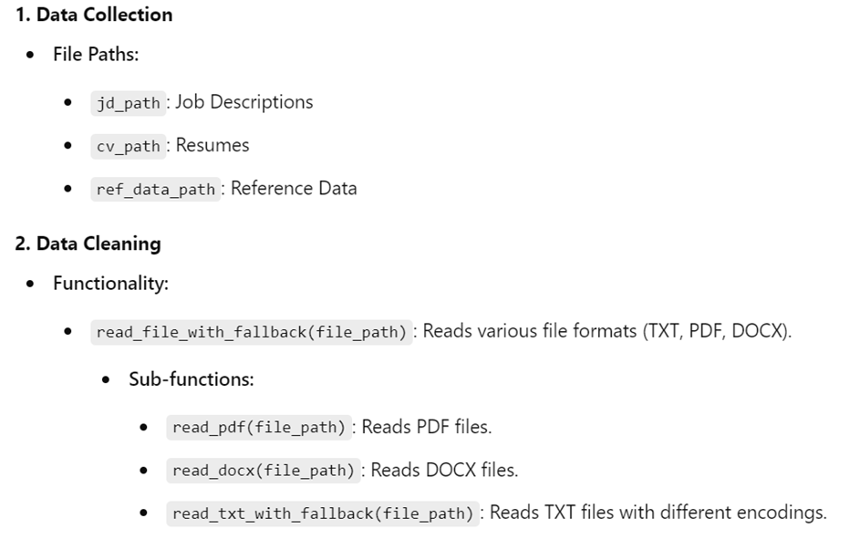
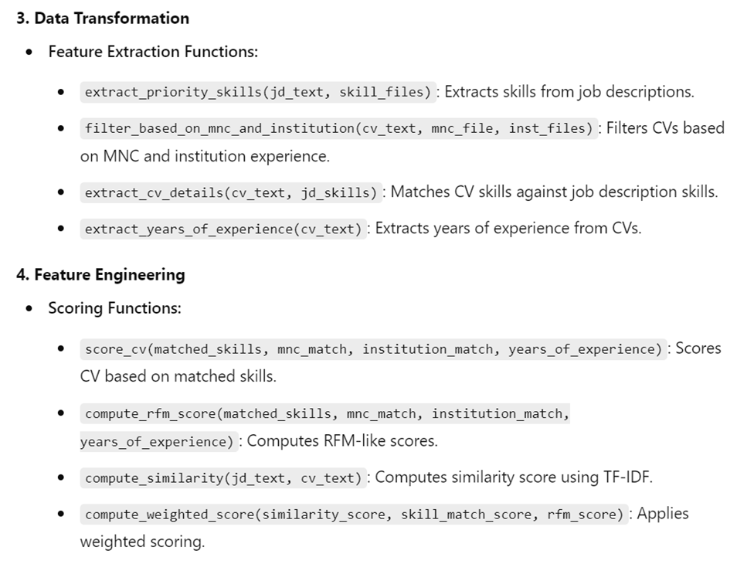
Testing and Validation

Slide 12
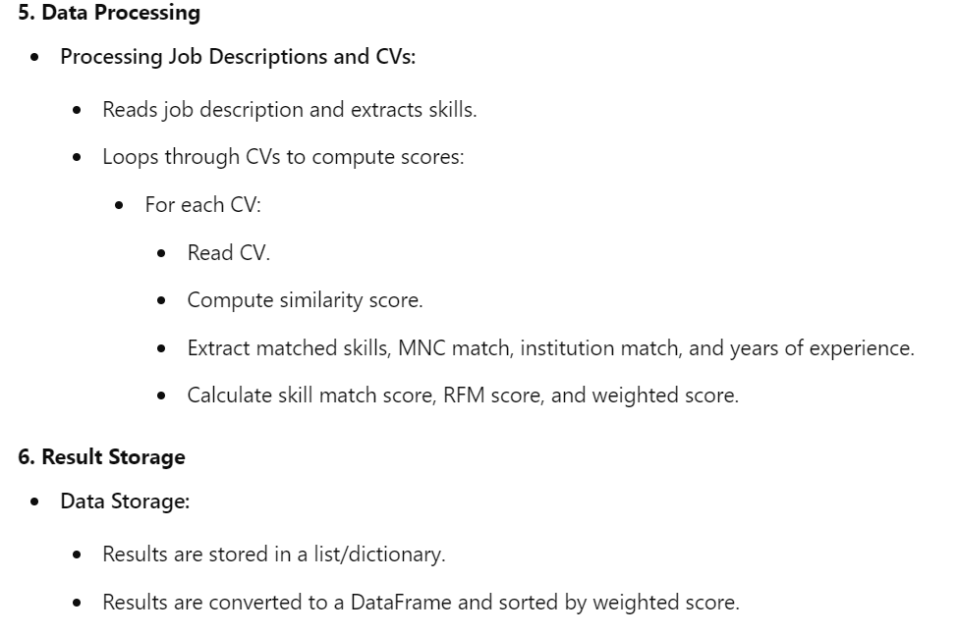
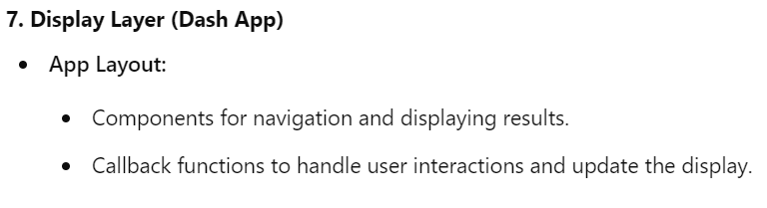
Testing and Validation

Slide 13
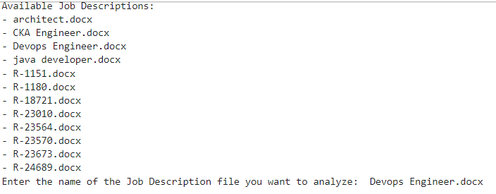
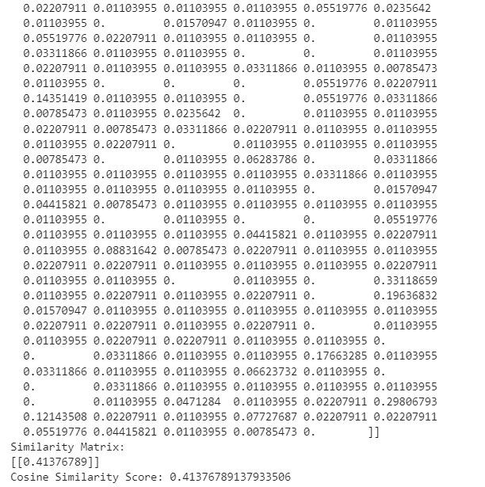
Testing and Validation
3. Results of Testing:
filename | similarity_score | predicted_label
Abhilash Subudhi.pdf | 0.146065417 | 0
Abhishek.pdf | 0.175667353 | 1
Anil Kumar.docx | 0.062097902 | 0
ANKITA.docx | 0.210727936 | 1
AradhanaTripathi.docx | 0.083968155 | 0
Buddha Vamsi.docx | 0.039520173 | 0
ChinnaSubbarayuduM.docx | 0.113971771 | 1
Dandamudi, Vijaya Krishna Amrutha.pdf | 0.101173417 | 1
Deepak reddy.docx | 0.067880509 | 0
Dineshkumar.pdf | 0.335759033 | 1
Gopi Krishna.docx | 0.117275209 | 1
HariNarayana.docx | 0.04675678 | 0
Harsha.docx | 0.230406936 | 1
Himaja G.docx | 0.0893528 | 1
TI-IDF Vectors with cosine similarity
a. Select the jd from the list,
b. Predict_label for the cvs based on threshold

Slide 14
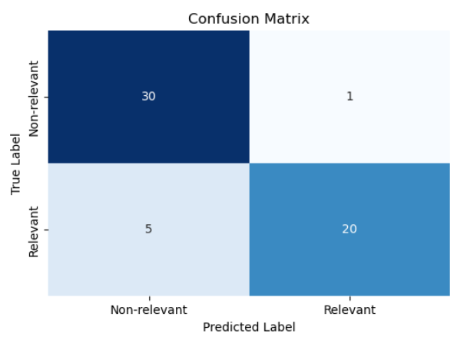
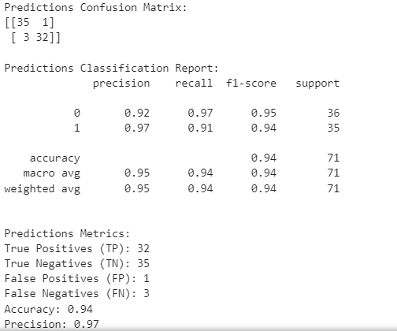
Testing and Validation
Confusion matrix and classification report
Class | Precision | Recall | F1-Score | Support
Class 0 | 0.92 | 0.97 | 0.95 | 36
Class 1 | 0.97 | 0.91 | 0.94 | 35
Type | Precision | Recall | F1-Score | Support
Macro Avg | 0.95 | 0.94 | 0.94 | 71
Weighted Avg | 0.95 | 0.94 | 0.94 | 71
Metrics | Values
True Positives (TP) | 32
True Negatives (TN) | 35
False Positives (FP) | 1
False Negatives (FN) | 3
Accuracy | 0.94
Precision | 0.97

Slide 15

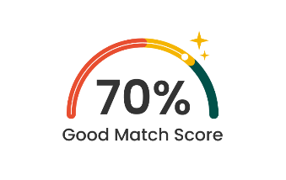
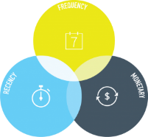


Analysis and Results
Evaluation Metrics
Similarity Score: Measures how similar the candidate's CV is to the job description or role requirements
Skill Match Score: Quantifies how well the candidate's skills align with the required skills for the job.
RFM Score: Refers to the Recency, Frequency, and Monetary score, typically used to evaluate engagement or relevance (in this case, likely referring to how recent and frequent the candidate's experiences are and their level of experience).
Weighted Score: A combination of various factors (like similarity score, skill match, etc.) with different weights assigned.
Years of Experience: Reflects the total years of professional experience of the candidate.

Slide 16
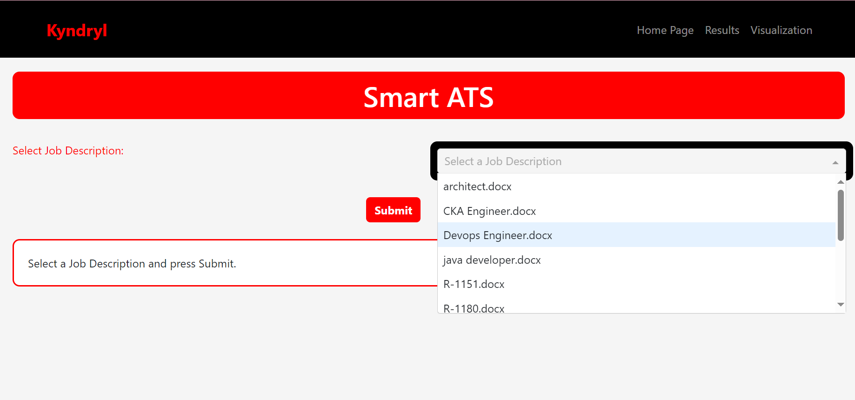
Demo
Page 1

Slide 17
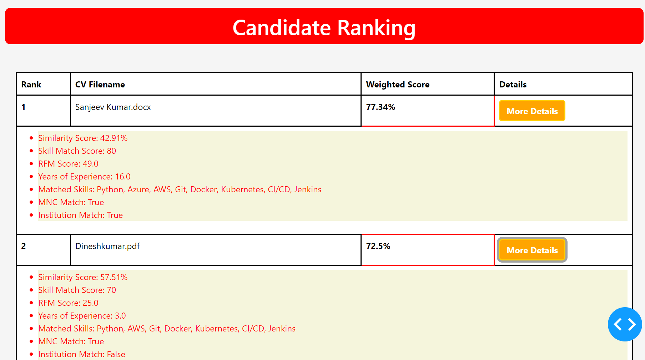
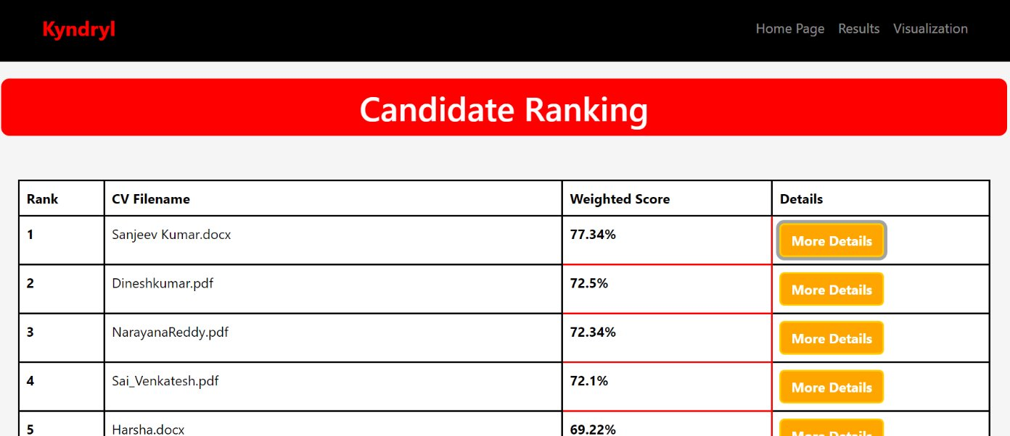
Demo
Page 2 ( When more details is toggled)

Slide 18
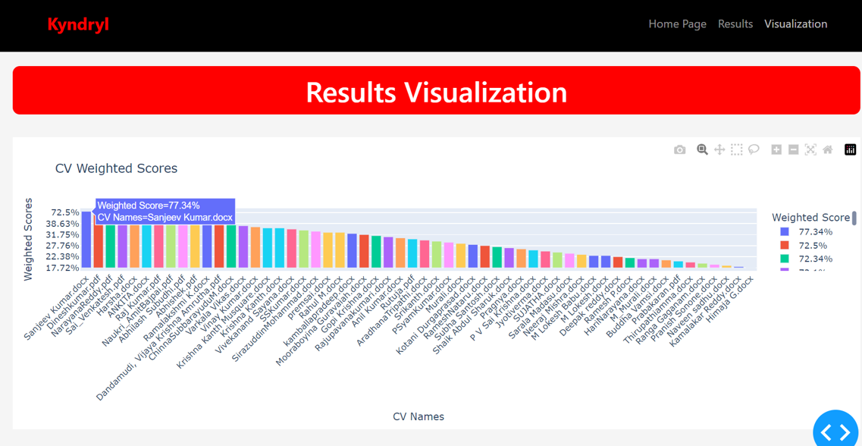
Demo
Visualization

Slide 19

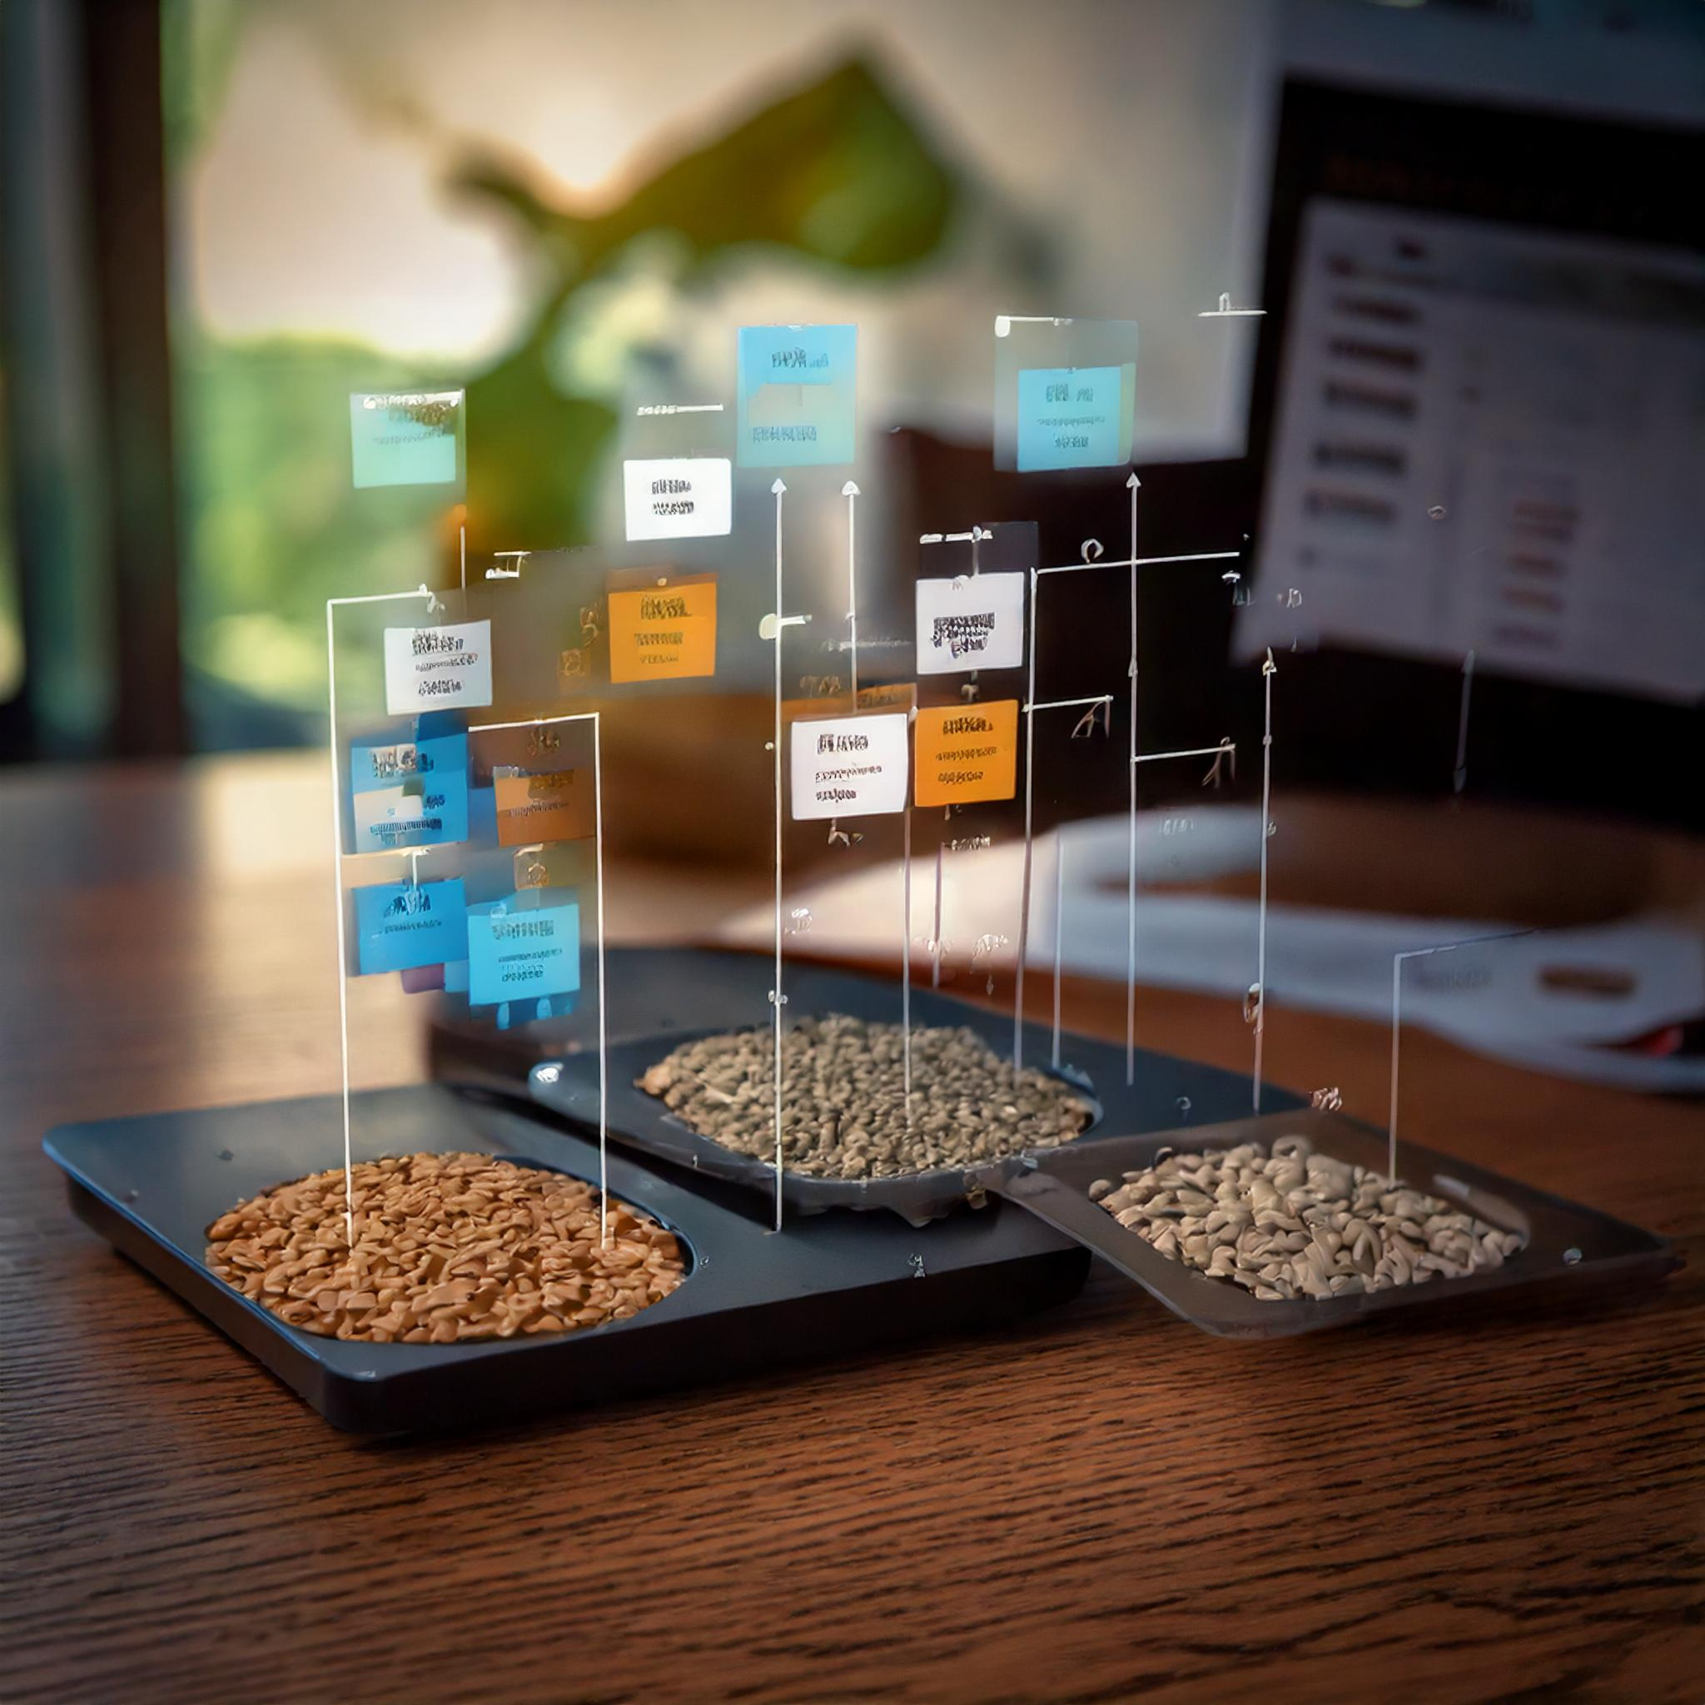

Next Step
Implement NLP Models: Incorporate advanced NLP models like BERT or GPT to improve semantic understanding in resume screening.
Refine Weight Distribution: Adjust weights of key metrics, such as skill match and RFM, to align with role-specific priorities.
Continuous Feedback: Introduce real-time feedback loops and manual review for improving accuracy and minimizing mismatches.

Slide 20



Future Scope
Continuous Model Improvement: Train the AI model on new data to refine its accuracy and relevance, leveraging feedback and new datasets.
Real-Time Feedback: Develop features for real- time status updates and automated interview scheduling, enhancing candidate engagement.
HR System Integration: Seamlessly integrate the Al system with major HR platforms (e.g., Workday) to automate candidate tracking and shortlisting.

